Slide 1
Creating a Successful Kickstarter Campaign
By Matthew Pan

Slide 2
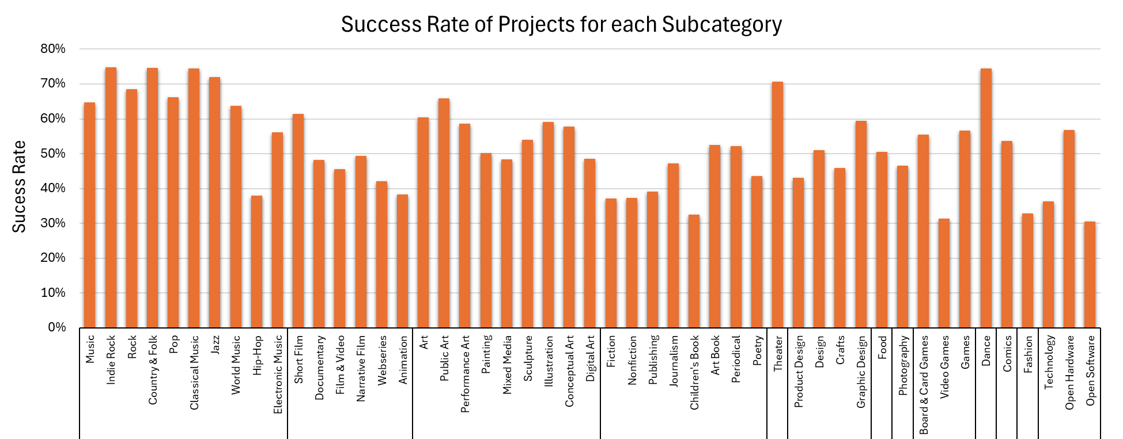
Which project category had the highest success in reaching its funding goal?
75%
(1358)
75%
(739)
75%
(527)
32%
(176)
31%
(237)
31%
(72)
Music
Film & Video
Art
Publishing
Design
Games
Technology
Highest Success Rate: Music and Dance
Lowest Success Rate: Video Games and Open Software

Slide 3
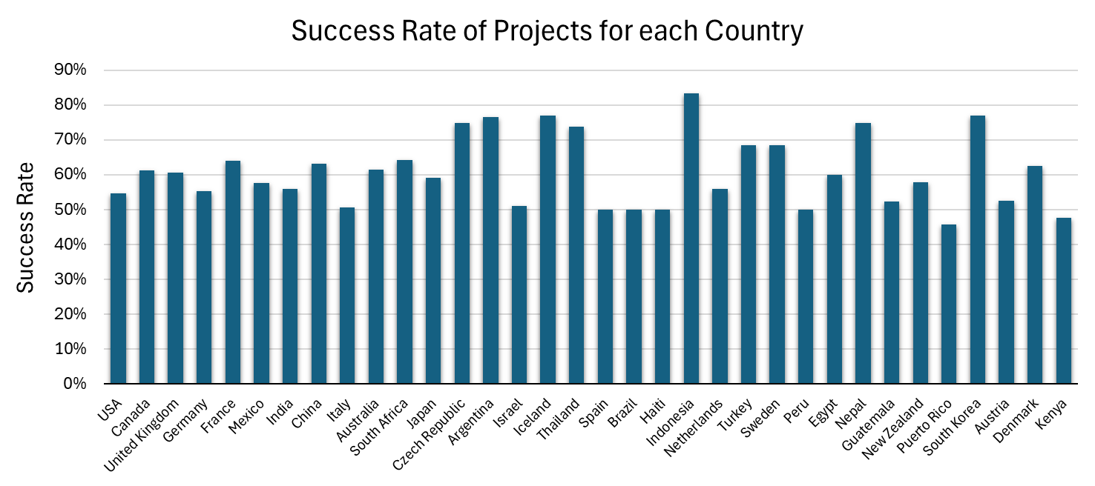
What is the success rate of projects across different states and countries?
US States | Success Rate | No. of Successful Projects
Vermont | 68% | 113
Rhode Island | 66% | 123
New York | 65% | 4329
Nevada | 38% | 120
Florida | 37% | 520
Wyoming | 19% | 5
77%
(23)
77%
(20)
83% (15)
77%
(10)
55%
(21081)
46%
(11)
48%
(10)
USA highest no. of successful projects but only 55% success rate
Top 3 US States in terms of Success Rate: Vermont, Rhode Island, and New York

Slide 4
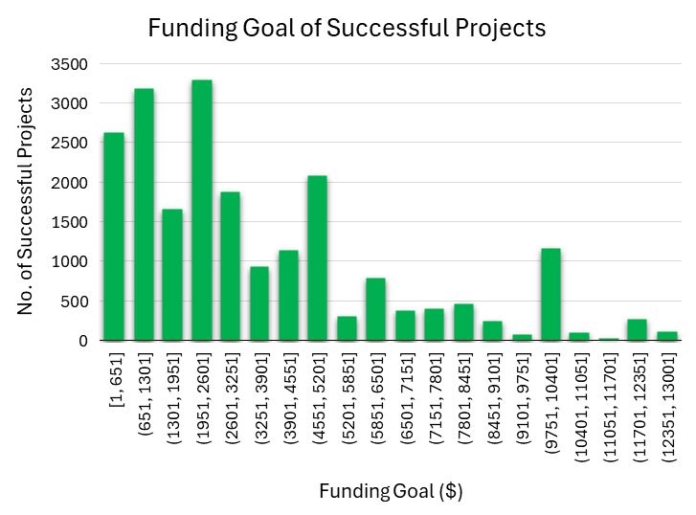
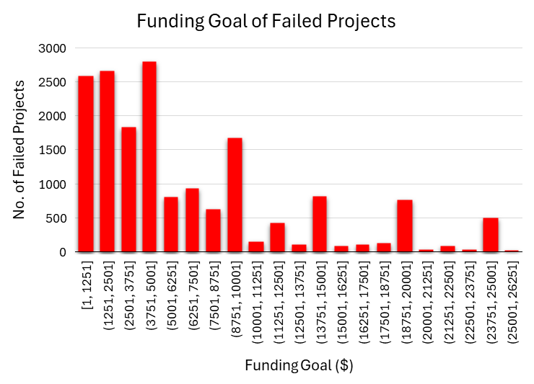
What is the difference between successful and failed projects?
On average, successful projects have lower priced funding goals
More realistic target for backers
Statistic | Successful | Failed
Mean | $3523 | $6800
Median | $2500 | $5000
Mode | $5000 | $5000
Range | $12999 | $26110

Slide 5
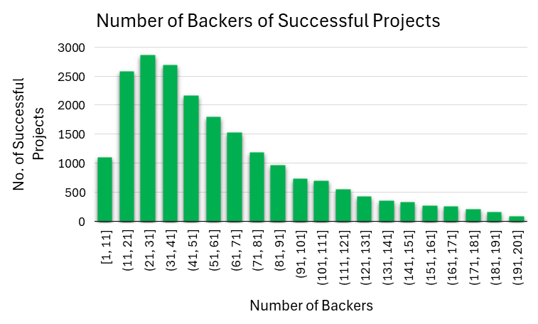
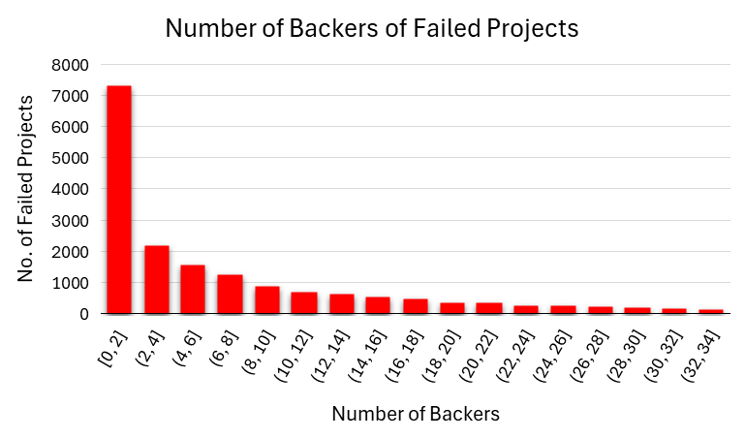
What is the difference between successful and failed projects?
Common bracket for successful projects is 21 to 31 backers
Important metric for success
Statistic | Successful | Failed
Mean | 59 | 7
Median | 47 | 4
Mode | 25 | 0
Range | 196 | 34

Slide 6
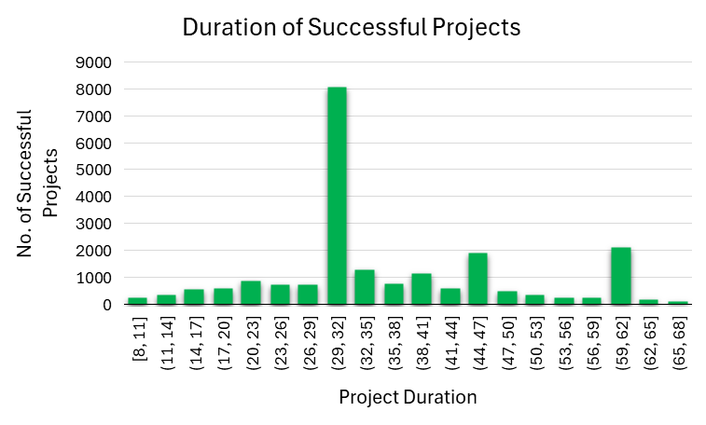
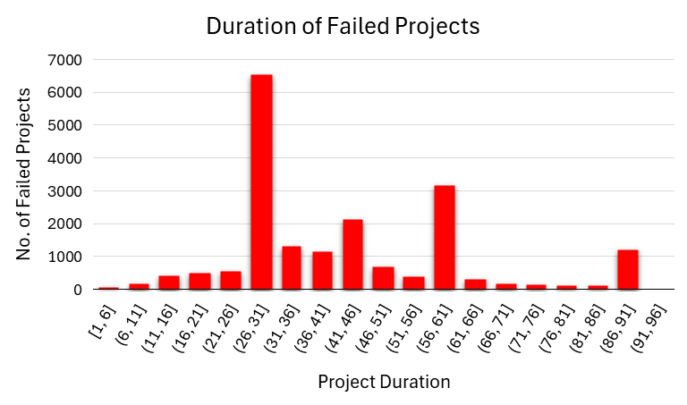
What is the difference between successful and failed projects?
On average, project duration is lower for successful projects
Creates a sense of urgency
Statistic | Successful | Failed
Mean | 36 | 43
Median | 30 | 36
Mode | 30 | 30
Range | 60 | 91

Slide 7





Business Recommendation
Category
Choose a topic which appeals to a large audience with no need for domain-specific knowledge (e.g. music)
Location
Pick a location with strong community support for creatives and a vibrant crowdfunding ecosystem
Funding Goal
Set a realistic and affordably priced funding goal (e.g. $1950-$2600)
Backers
Aim to attract between 21 to 31 backers for your project
Duration
A project duration not exceeding 30 days
Notes:
As a data analyst, my role is to analyze data and derive meaningful insights that can inform business decisions. Based on my analysis, I am proposing a recommendation that aims to improve business performance and drive growth. This recommendation is backed by thorough data analysis, trends observation, and market research, ensuring a data-driven approach to decision-making.

Slide 8
Any Questions?
Thank you for listening ☺

Slide 9
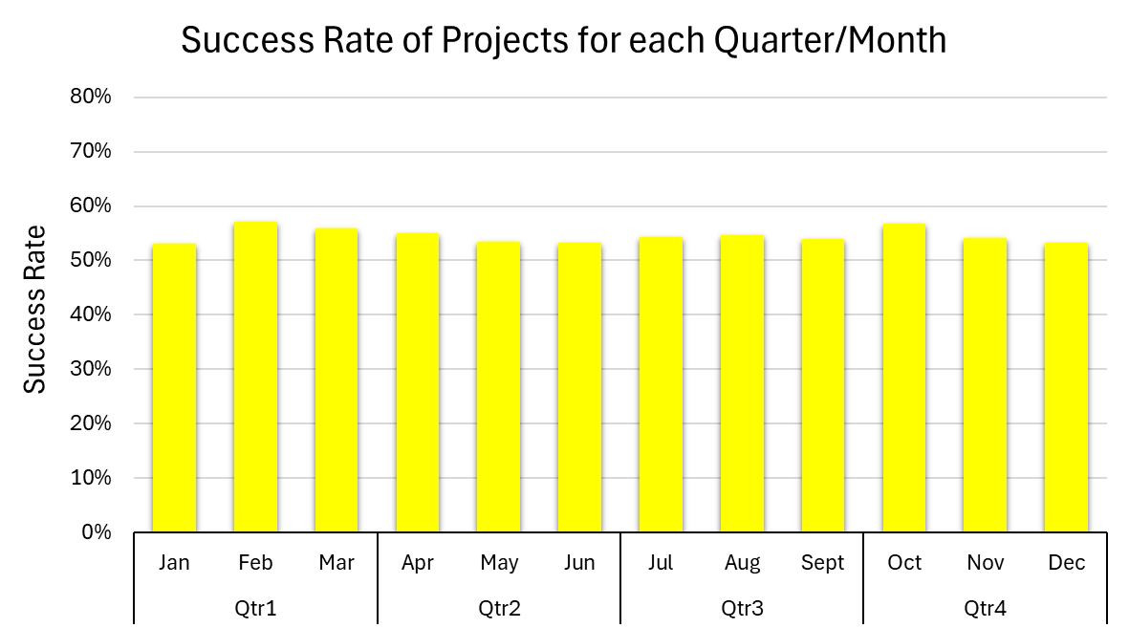
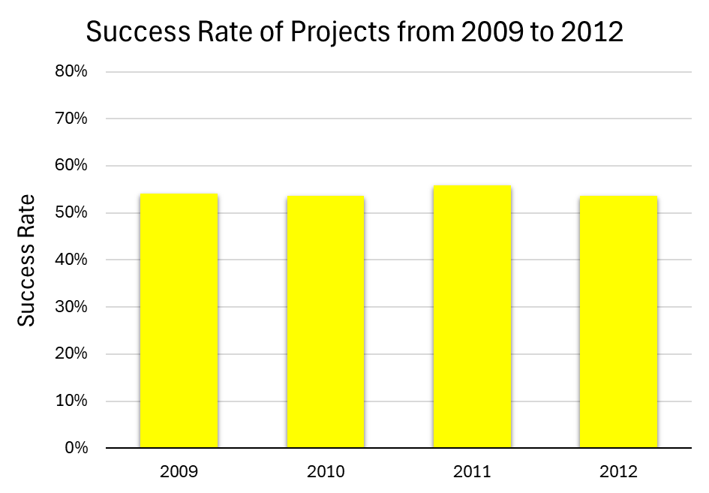
Does the launch date of the project have a significant impact on its success?
Launch dates of projects do not have a significant impact on its success

Slide 10
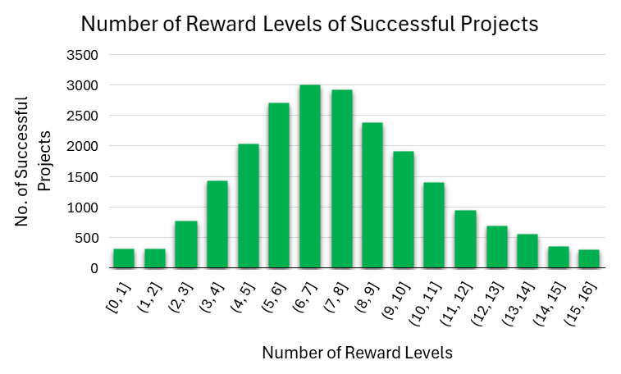
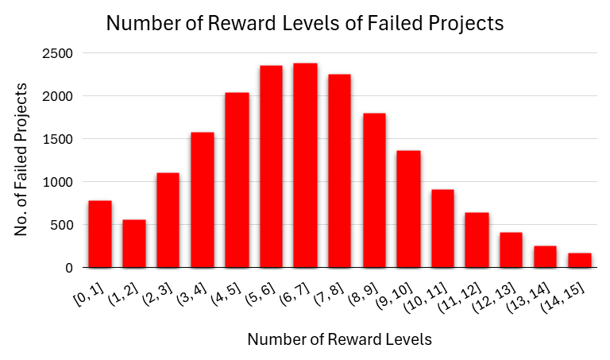
Reward Levels VS Success of Projects
Statistic | Successful | Failed
Mean | 8 | 7
Median | 8 | 7
Mode | 7 | 7
Range | 16 | 15
No. of reward levels of projects do not have a significant impact on its success

Slide 11
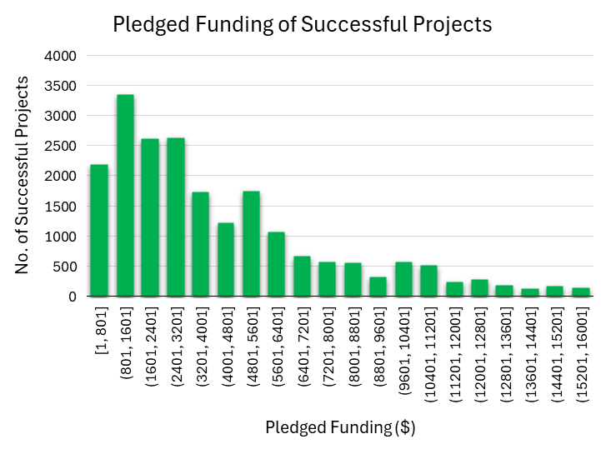
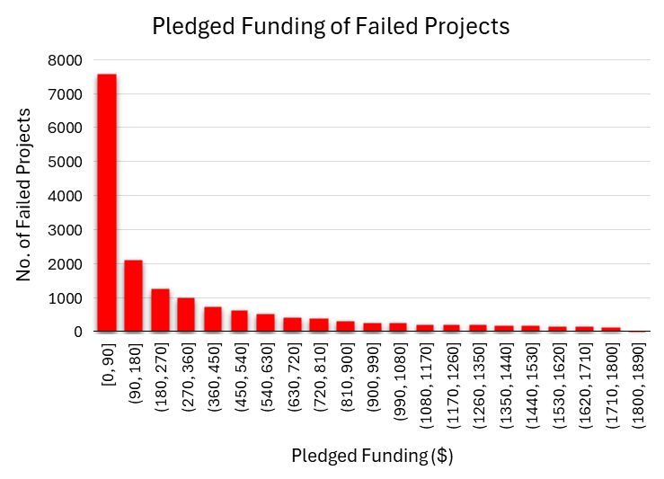
Pledged Funding VS Success of Projects
Statistic | Successful | Failed
Mean | $4187 | $306
Median | $3102 | $115
Mode | $1000 | $0
Range | $15649 | $1820
Successful projects received more pledged funding than failed projects.

